Slide 1
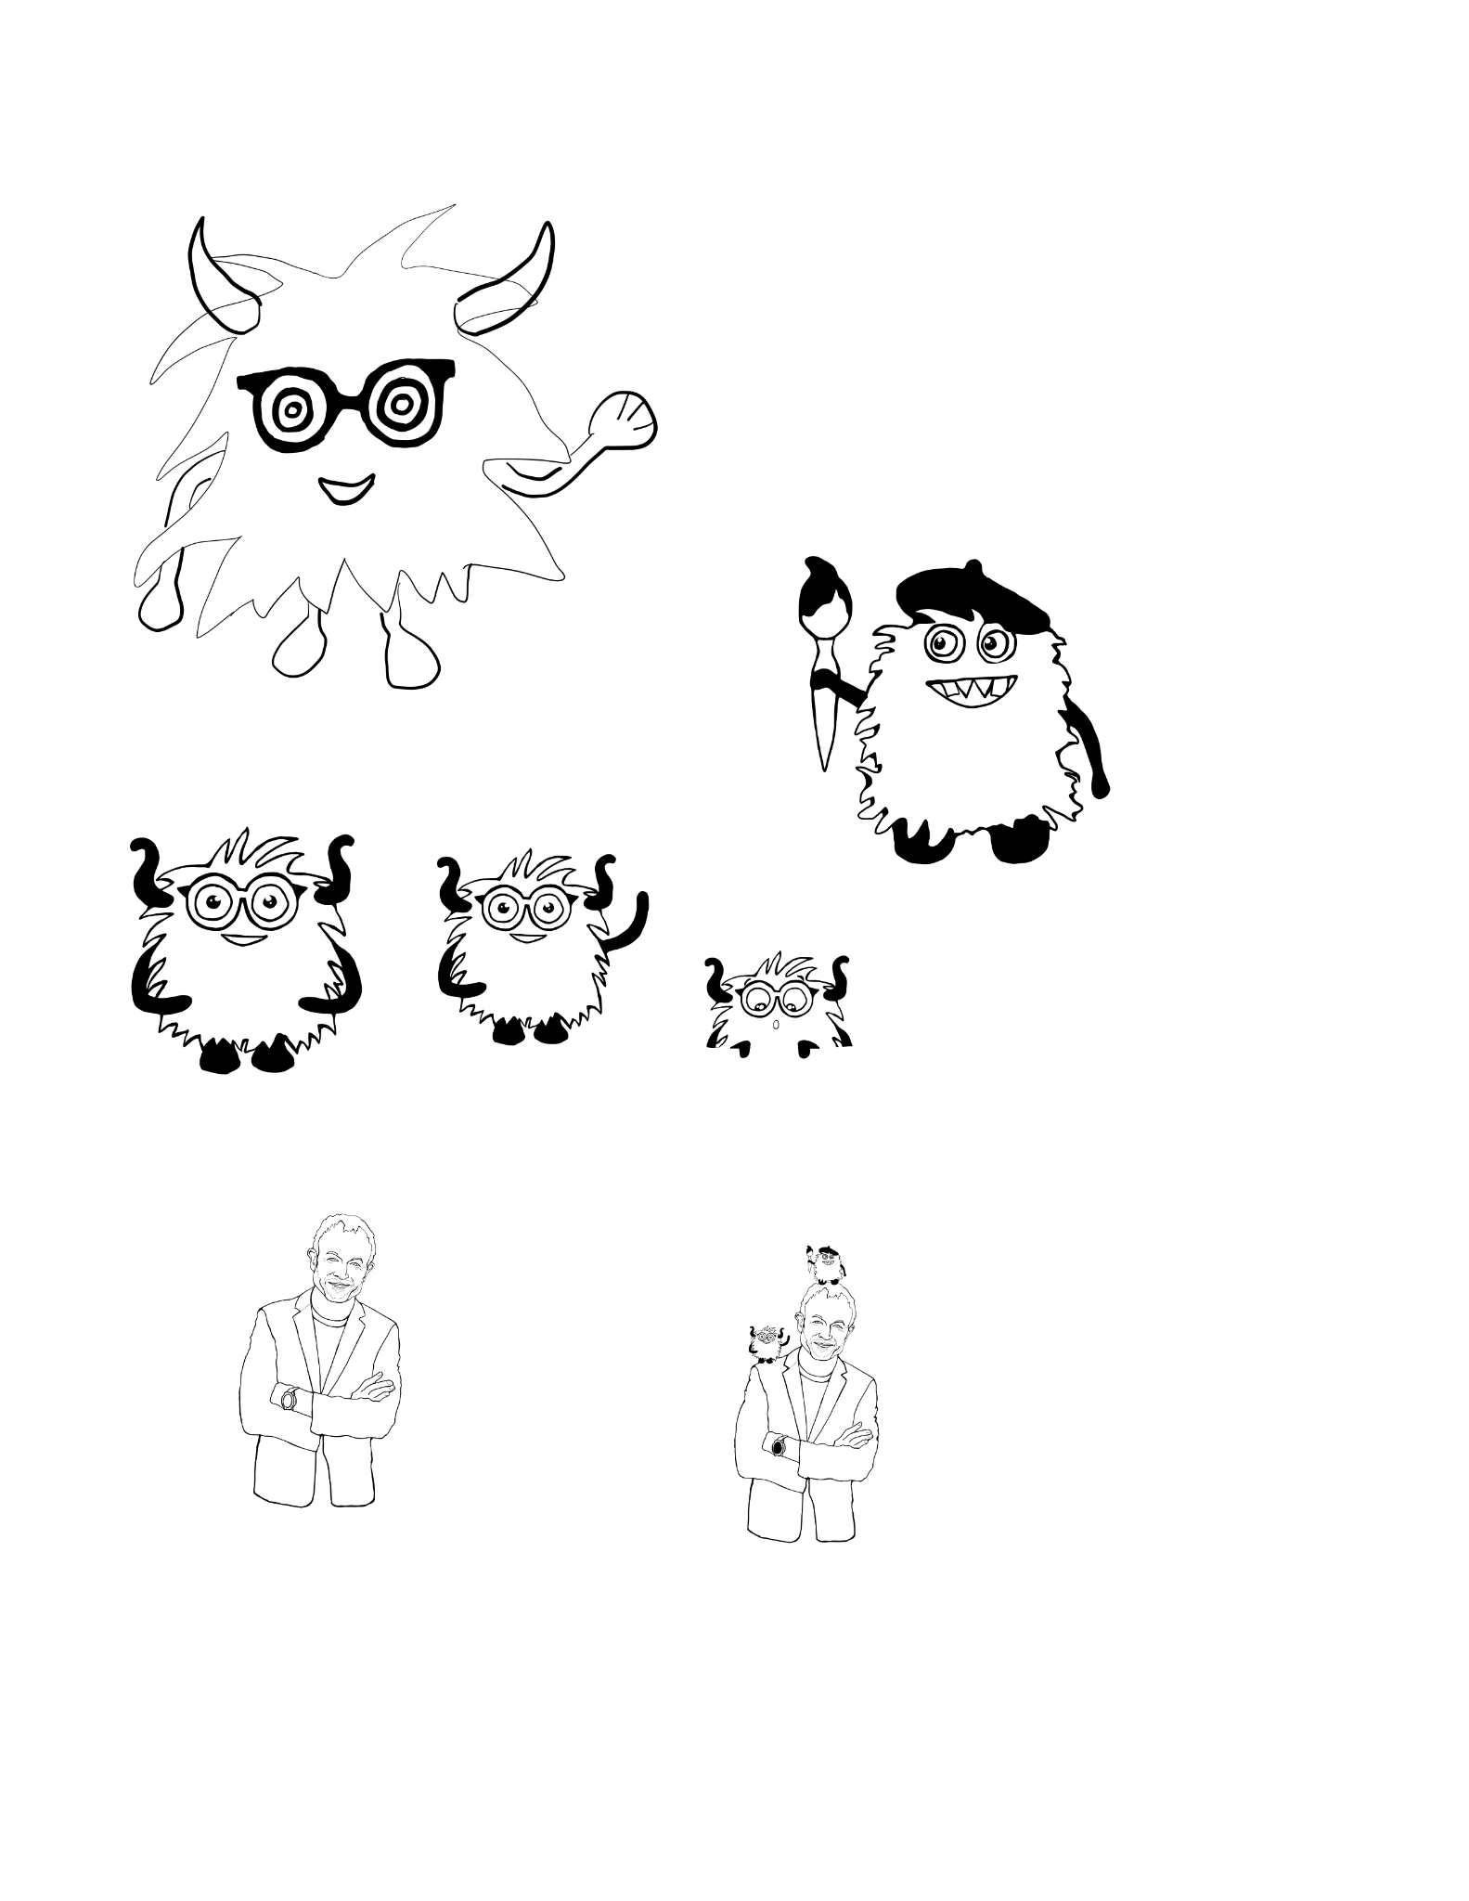
Design Ideas
By InnFlow Team
December 2023

Slide 2

Sofia Design 06/12/2024
Based on Harry’s design

Slide 3
Empty Slide Title
Subtitle

Slide 4
Stickers
Little library of stickers
A.I Monsters
Colours

